Slide 1


Network Model Types of Network: Personal Area Network, Local Area Network Metropolitan Area Network, Wide Area Network Piconet, Ethernet, Fast Ethernet, Metro Ethernet, Internetwork
Lecture # 7 and 8
Week# 4
Data Communications and Networking, Fourth Edition, Behrouz A. Forouzan

Slide 2
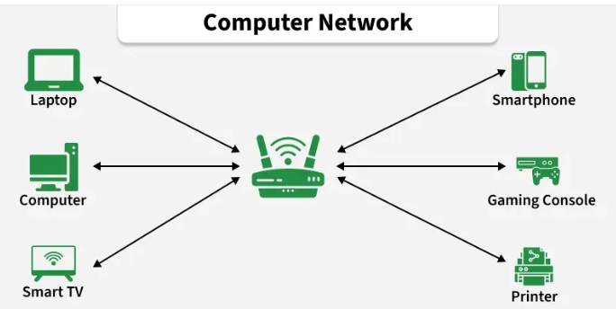
Computer Networks
A computer network is a system of interconnected devices, such as computers, servers, smartphones, and printers, that communicate to exchange data. They communicate using wired or wireless connections and can range from small home networks to the global Internet
Simple Example:
Computers in a school lab connected to one printer
Mobile phones connected to the same Wi-Fi
ATMs connected to bank servers
All these are computer networks

Slide 3
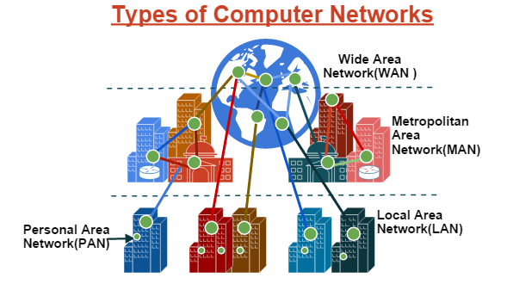
Types of Computer Networks

Slide 4
Personal Area Network (PAN)
What is PAN?
A Personal Area Network is a small network used by one person to connect personal devices.
Range: Few meters (around a room)
How PAN Works (Easy)
Devices connect using Bluetooth.
One device usually controls others
Examples
Mobile phone connected to Bluetooth earbuds
Laptop connected to wireless mouse
Phone sharing internet via hotspot
Real-Life Example
Your phone + smartwatch + earbuds = PAN

Slide 5
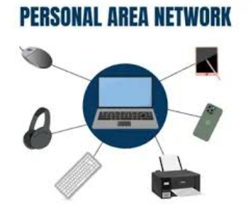
Personal Area Network (PAN)

Slide 6
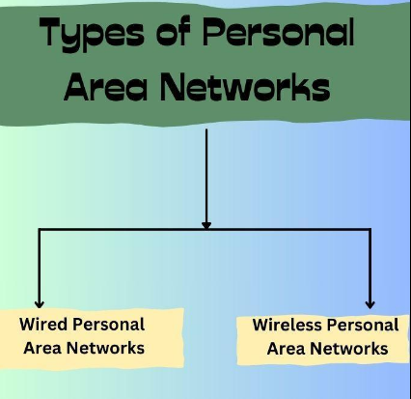
Types of Personal Area Network

Slide 7
Wired PAN
A Wired PAN connects personal devices using physical cables.
How Wired PAN Works
Devices are connected using data cables
Data travels through wires
Very stable connection
Examples
Mobile phone connected to laptop via USB cable
Printer connected to computer using USB
External hard drive connected to PC
Real-Life Example
Connecting your phone to a laptop using a charging/data cable to transfer photos.

Slide 8
Wireless PAN (WPAN)
Wireless PAN connects devices without cables, using wireless technologies.
Technology Used
Bluetooth
How Wireless PAN Works
Devices communicate using radio waves
One device may act as controller
Short-range communication
Examples
Bluetooth headphones connected to phone
Wireless mouse and keyboard
Smartwatch connected to mobile
Real-Life Example
Phone connected to Bluetooth earbuds = Wireless PAN

Slide 9
Local Area Network (LAN)
Local Area Network connects computers within a small area, like:
Home
Office
School
Lab
Range: Building or campus
How LAN Works
Devices connect through Ethernet cables or Wi-Fi
A switch or router manages data flow
Examples
Computer lab in a university
Office computers sharing printer
Home Wi-Fi network
Real-Life Example
All computers in your department lab connected together = LAN

Slide 10
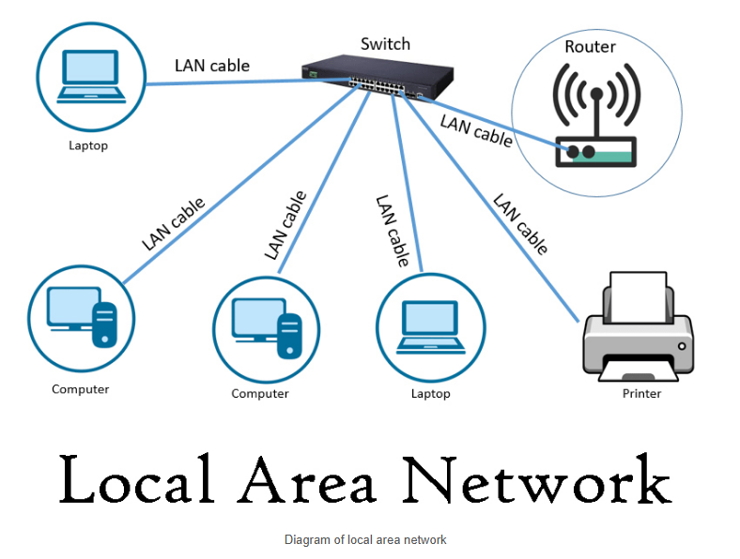
Local Area Network (LAN)

Slide 11
Metropolitan Area Network (MAN)
Metropolitan Area Network connects multiple LANs within a city.
Range: City or large campus area
How MAN Works
Uses fiber optic cables
Usually managed by large organizations
Examples
University campuses across a city
Cable TV networks
City-wide Wi-Fi
Real-Life Example
All branches of a university in one city connected = MAN

Slide 12
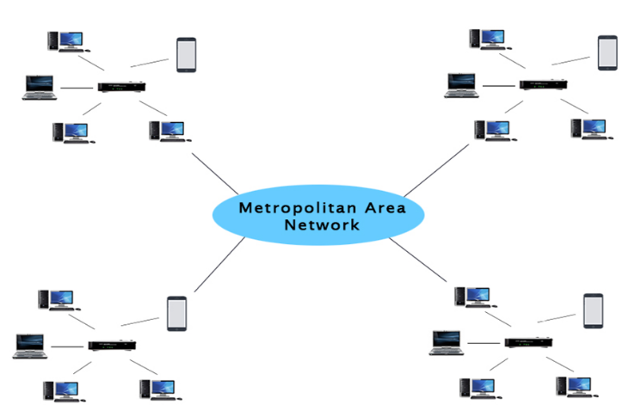
Metropolitan Area Network (MAN)

Slide 13
Wide Area Network (WAN)
Wide Area Network connects networks across countries or the world.
Range: Country to worldwide
How WAN Works
Uses satellites, undersea cables, fiber
Routers forward data over long distances
Examples
WhatsApp Message worldwide
YouTube Video
Online Shopping
Real-Life Example
You accessing Google servers from Pakistan = WAN

Slide 14
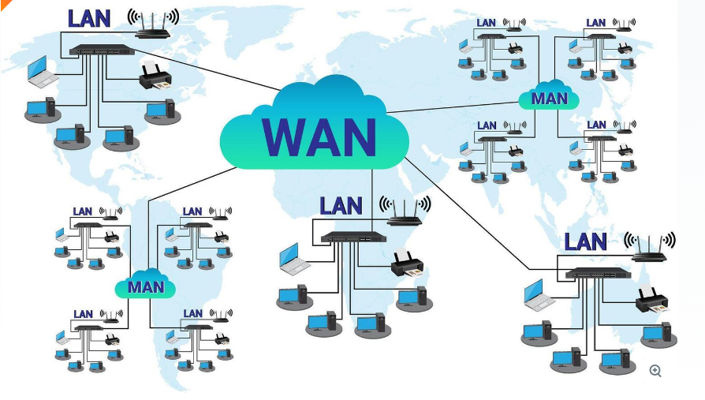
Wide Area Network (WAN)

Slide 15
What is a Piconet?
A Piconet is a very small wireless network made using Bluetooth.
Piconet = One main Bluetooth device + a few nearby Bluetooth devices
Master Device
The main device
Controls communication
Decides who can talk and when
Slave Devices
Other devices connected to the master
Follow instructions from master
Rule:
1 master
Up to 7 slave devices
Example
You connect:
Bluetooth earbuds
Smartwatch
Car Bluetooth
All connected to one phone
This group is called a Piconet.

Slide 16
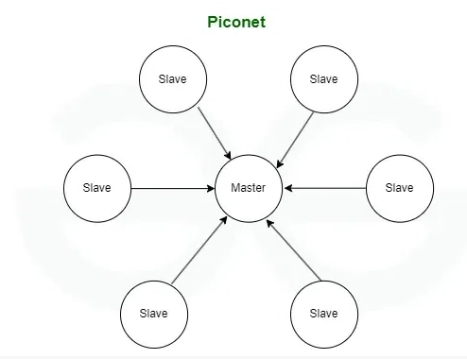
Piconet

Slide 17
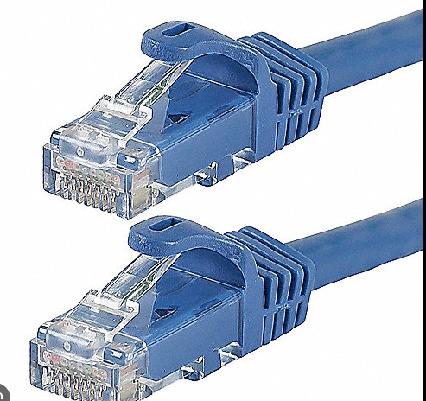
Ethernet
Ethernet is the most common wired LAN technology.
How Ethernet Works
Uses Ethernet cables
Data sent in frames
Uses MAC addresses
Examples
Desktop connected via LAN cable
Office wired networks
Speed
10 Mbps (basic Ethernet)

Slide 18
Fast Ethernet
Fast Ethernet is a faster version of normal Ethernet used in local area networks (LAN).
Same network type, same cables — but higher speed
How It Works
Same working as Ethernet
Faster data transfer
Speed
100 times better then simple Ethernet
Examples
Small office networks

Slide 19
Metro Ethernet
Metro Ethernet extends Ethernet technology to a city level network.
Used to connect multiple LANs across a city.
Key Features
Covers metropolitan (city) area
Uses fiber optic cables
Very high speed
Used by large organizations
Speed
Example
Connecting company branches in one city
University campuses across a city

Slide 20
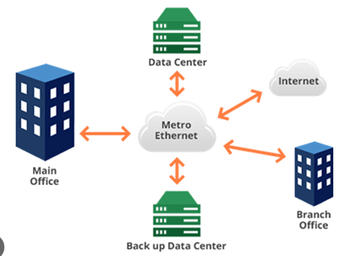
Metro Ethernet

Slide 21
Comparasion Table
Feature | Ethernet | Fast Ethernet | Metro Ethernet
Speed | 10 Mbps | 100 Mbps | 1–10 Gbps
Area | LAN (small) | LAN (small/medium) | City (MAN)
Cable | Copper | Copper | Fiber optic
Cost | Low | Medium | High
Usage | Old LANs | Modern LANs | City-wide networks

Slide 22
Internetwork
An internetwork is formed by connecting two or more networks.
Internet (largest internetwork)
Company LAN + WAN + MAN combined
The Internet itself is the largest internetwork (because it connects millions of networks worldwide)
Example
Your home Wi-Fi is one network Google servers are another network
When you open Google:
Your home network connects to another network This connection = Internetwork

Slide 23
THANK YOU
You can Find me:
mehakrana.CS@tuf.edu.pk

